Slide 1
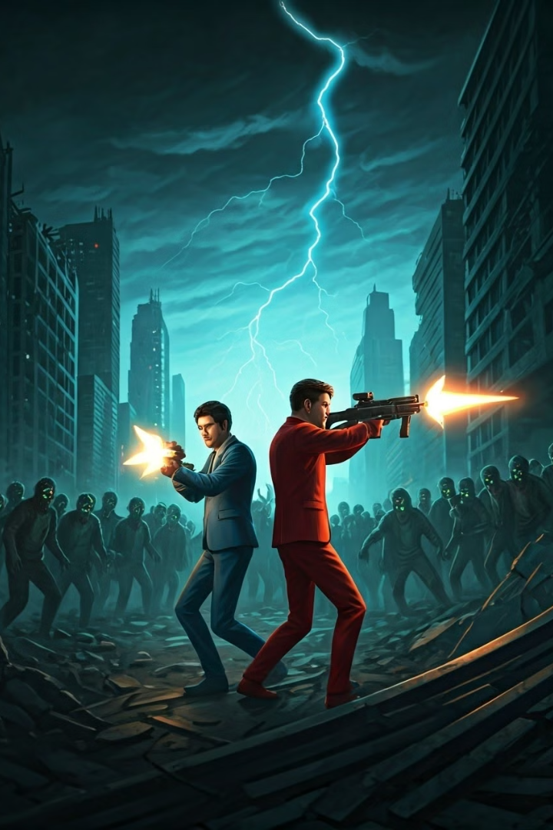

Dive into the thrilling world of "Zombie Rush"!
"Zombie Rush" is a thrilling game where you compete against your friend to survive waves of zombies. The goal is to achieve the highest score by shooting down zombies, dodging attacks, and collecting bonuses.
by Umair Arshad

Slide 2
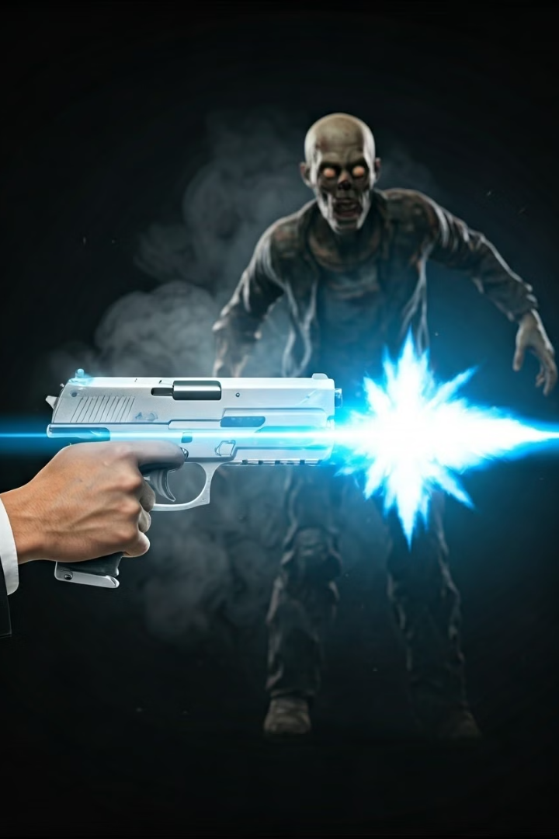
Objectives: Outlive and Outscore!
1
Survive the Zombie Waves
Dodge incoming zombies and manage your health to stay alive.
2
Compete for the High Score
Shoot down zombies and collect bonuses to outscore your opponent.
3
Strategic Gameplay
Make strategic decisions to maximize your score and outlast your friend.

Slide 3
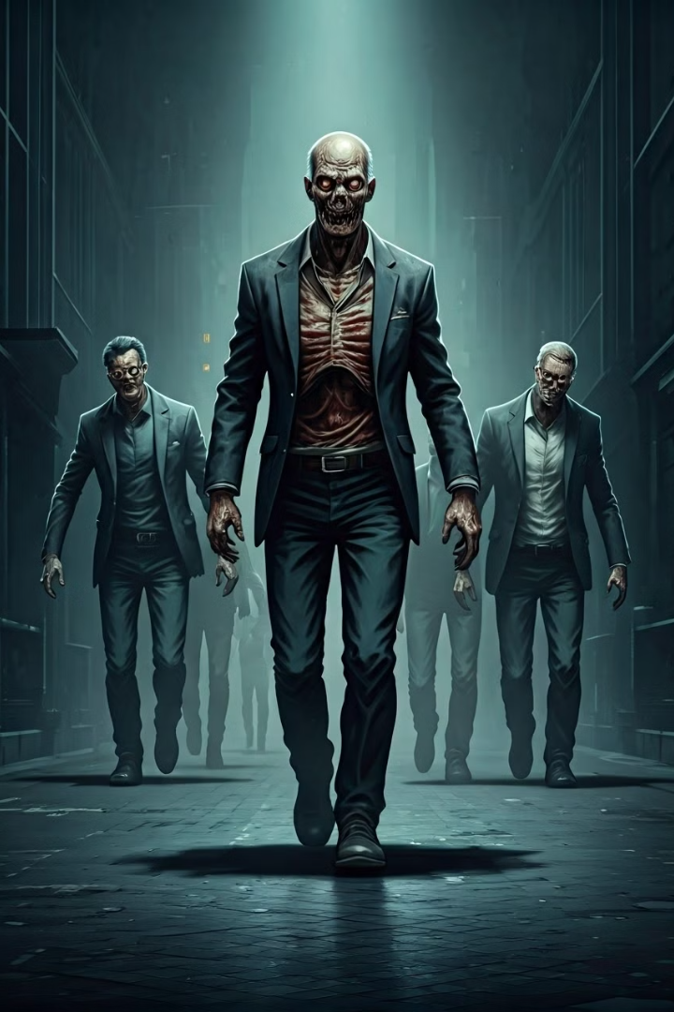
Levels and Challenges
1
Level 1
Start with a manageable wave of zombies.
2
Level 2
Zombies increase in speed and frequency.
3
Level 3
The most challenging level with relentless zombie attacks.

Slide 4
Game Components: Bringing the Action to Life
Backdrops
Sprites
Sounds
Immersive backdrops including the Start Menu, a dynamic ground background, and an Instructions backdrop.
Detailed sprites for players, zombies, bullets, bonuses, levels, buttons, and more.
Engaging background music, sound effects for zombie kills, bonus collections, and game events.

Slide 5
Controls: Master Your Movements
Player 1
Player 2
Use 'a', 's', 'd', 'w' keys to move and 'space' to shoot.
Use arrow keys to move and 'm' to shoot.

Slide 6




Bonus Features: Turn the Tide!
Health Restore
Replenish your health and stay in the game.
Gift Bonus
Earn random score boosts for a competitive edge.
Bullet Increase
Increase your firing rate to take down zombies faster.

Slide 7
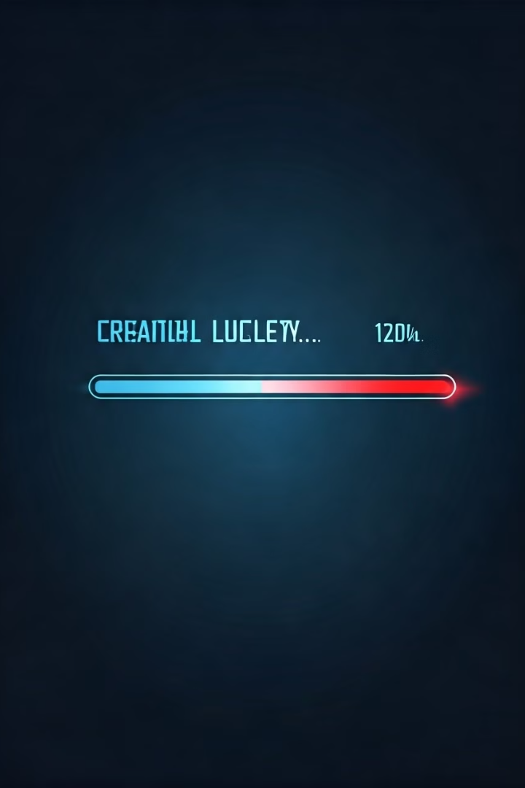
Lifeline and Game End
Health as Lifeline
Your health depletes upon contact with zombies. Collect health bonuses to survive longer.
Game End Conditions
The game ends when one player's health reaches zero or after completing three levels.

Slide 8

Get Ready for the Ultimate Zombie Showdown!
"Zombie Rush" offers a thrilling and dynamic multiplayer experience. With its engaging gameplay, strategic elements, and intense challenges, "Zombie Rush" guarantees a memorable gaming experience. Prepare to survive, outscore, and conquer the zombie horde!

